Slide 1
Sirius HDMI RX review
Huibo Zhong

Slide 2
Config
1. HDMI1.4, video up to 4k@30fps
2. ARCTX (2 ch spdif)
3. EDID ram inside
4. HDCP1.4
5. AUDIO.

Slide 3
TOP

Slide 4
PHY

Slide 5
CLK & RESET
CLK_AUDIO_HDMI | CLK_AUDIO_HDMI | iaudclk | 98.304 |  |  |  | PLL_AUDIO |  | 4.096mhz~98.304Mhz | HDMI_TOP
 | CLK_CFG_BUS_HDMI | hdmi cfg bus clock | 150 |  |  | CLK_CFG_150_G3 |  | 150 | fixed | HDMI_TOP
CLK_CFG_HDMI | CLK_CFG_HDMI | hdmi cfg clock | 50 |  |  |  | PLL_0 | 50 | fixed | HDMI_TOP
CLK_CEC_HDMI | CLK_CEC_HDMI | icecclk | 32k |  |  |  | From ABB_TOP | 32k | fixed | HDMI_TOP
HDMI_pon_rst_n | poweron reset |  | HDMI | N | TOP_RGU
HDMI_apb_rst_n | reset for apb |  | HDMI | N | TOP_RGU
HDMI_scanrst_n | scan reset | scan | HDMI |  | TOP_RGU
HDMI_JTAG_TRST_N | jtag reset | IO share | HDMI |  | TOP_RGU
HDMI_PHY_RESET | phy reset |  | HDMI | N | TOP_RGU

Slide 6
Audio data path

Slide 7
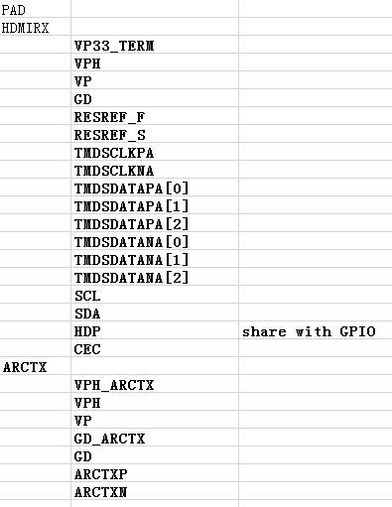
PIN and Port Mapping

Slide 8
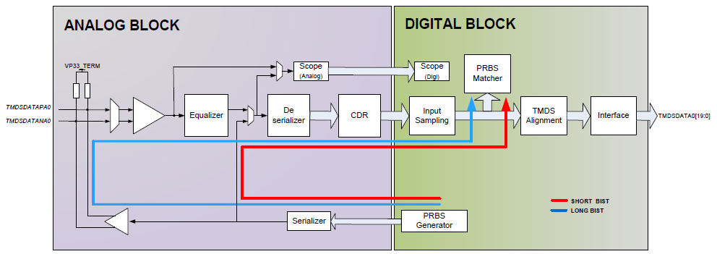
TEST
HDMI_ATE IN[15:0]
HDMI_ATE OUT[15:0]
HDMI_MON_OUT[31:0]
SCANMODE
BIST (long, short)

Slide 9
CTS
Signal for CTS:
SCL, SDA, SDA_PULL_DN_N, JTAG_TRST_N, JTAG_TCK, JTAG_TMS, JTAG_TDI, JTAG_TDO, JTAG_TDO_EN, I2C_JTAGZ, SVSRET_MODEZ, PHY_RESET, PDDQ, TMDSVALID, DTB[3:0], CFGCLK, CONT[5:0], CONT_EN, BISTOK, BISTDONE, BISTEN, CFGCLK_FREQ[1:0].

Slide 10
Status
IP level: config done, simulation done
Soc level : old noc bus done, new noc doing
Veloce : done
FPGA plan
Other status, check

